Slide 1
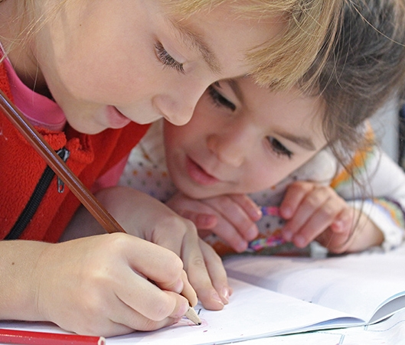
Starting a new school!
School
Month, year
I can’t wait!!!!!

Slide 2

Hi Friends!
My name is ______ and I'm starting a new school!

Slide 3
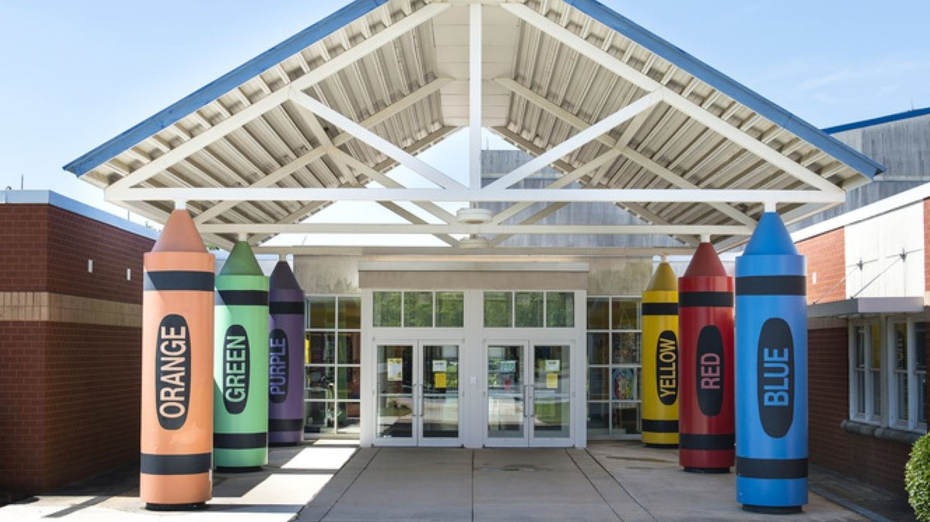
_______ Elementary will be my new school.
3

Slide 4
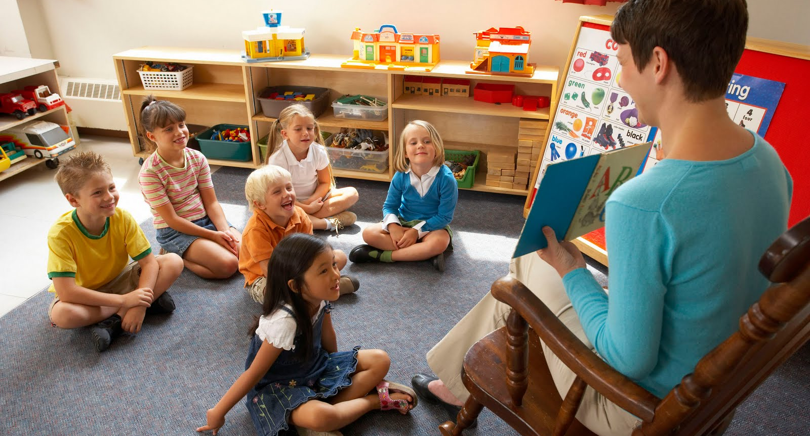
I will go to my new school, take off my backpack, say hello to my teacher and meet my new friends!
We will sing, play, and learn!
3

Slide 5

This is my teacher, Ms. _______
Ms. _______ is really kind. She will help me learn more words so I can read cool books! She will even teach me how to write my name!

Slide 6

These are my new friends
Making new friends can be scary, but I will do my best and soon I will have lots of new friends! We will share toys and books and play games during recess! Making new friends will be so much fun!

Slide 7
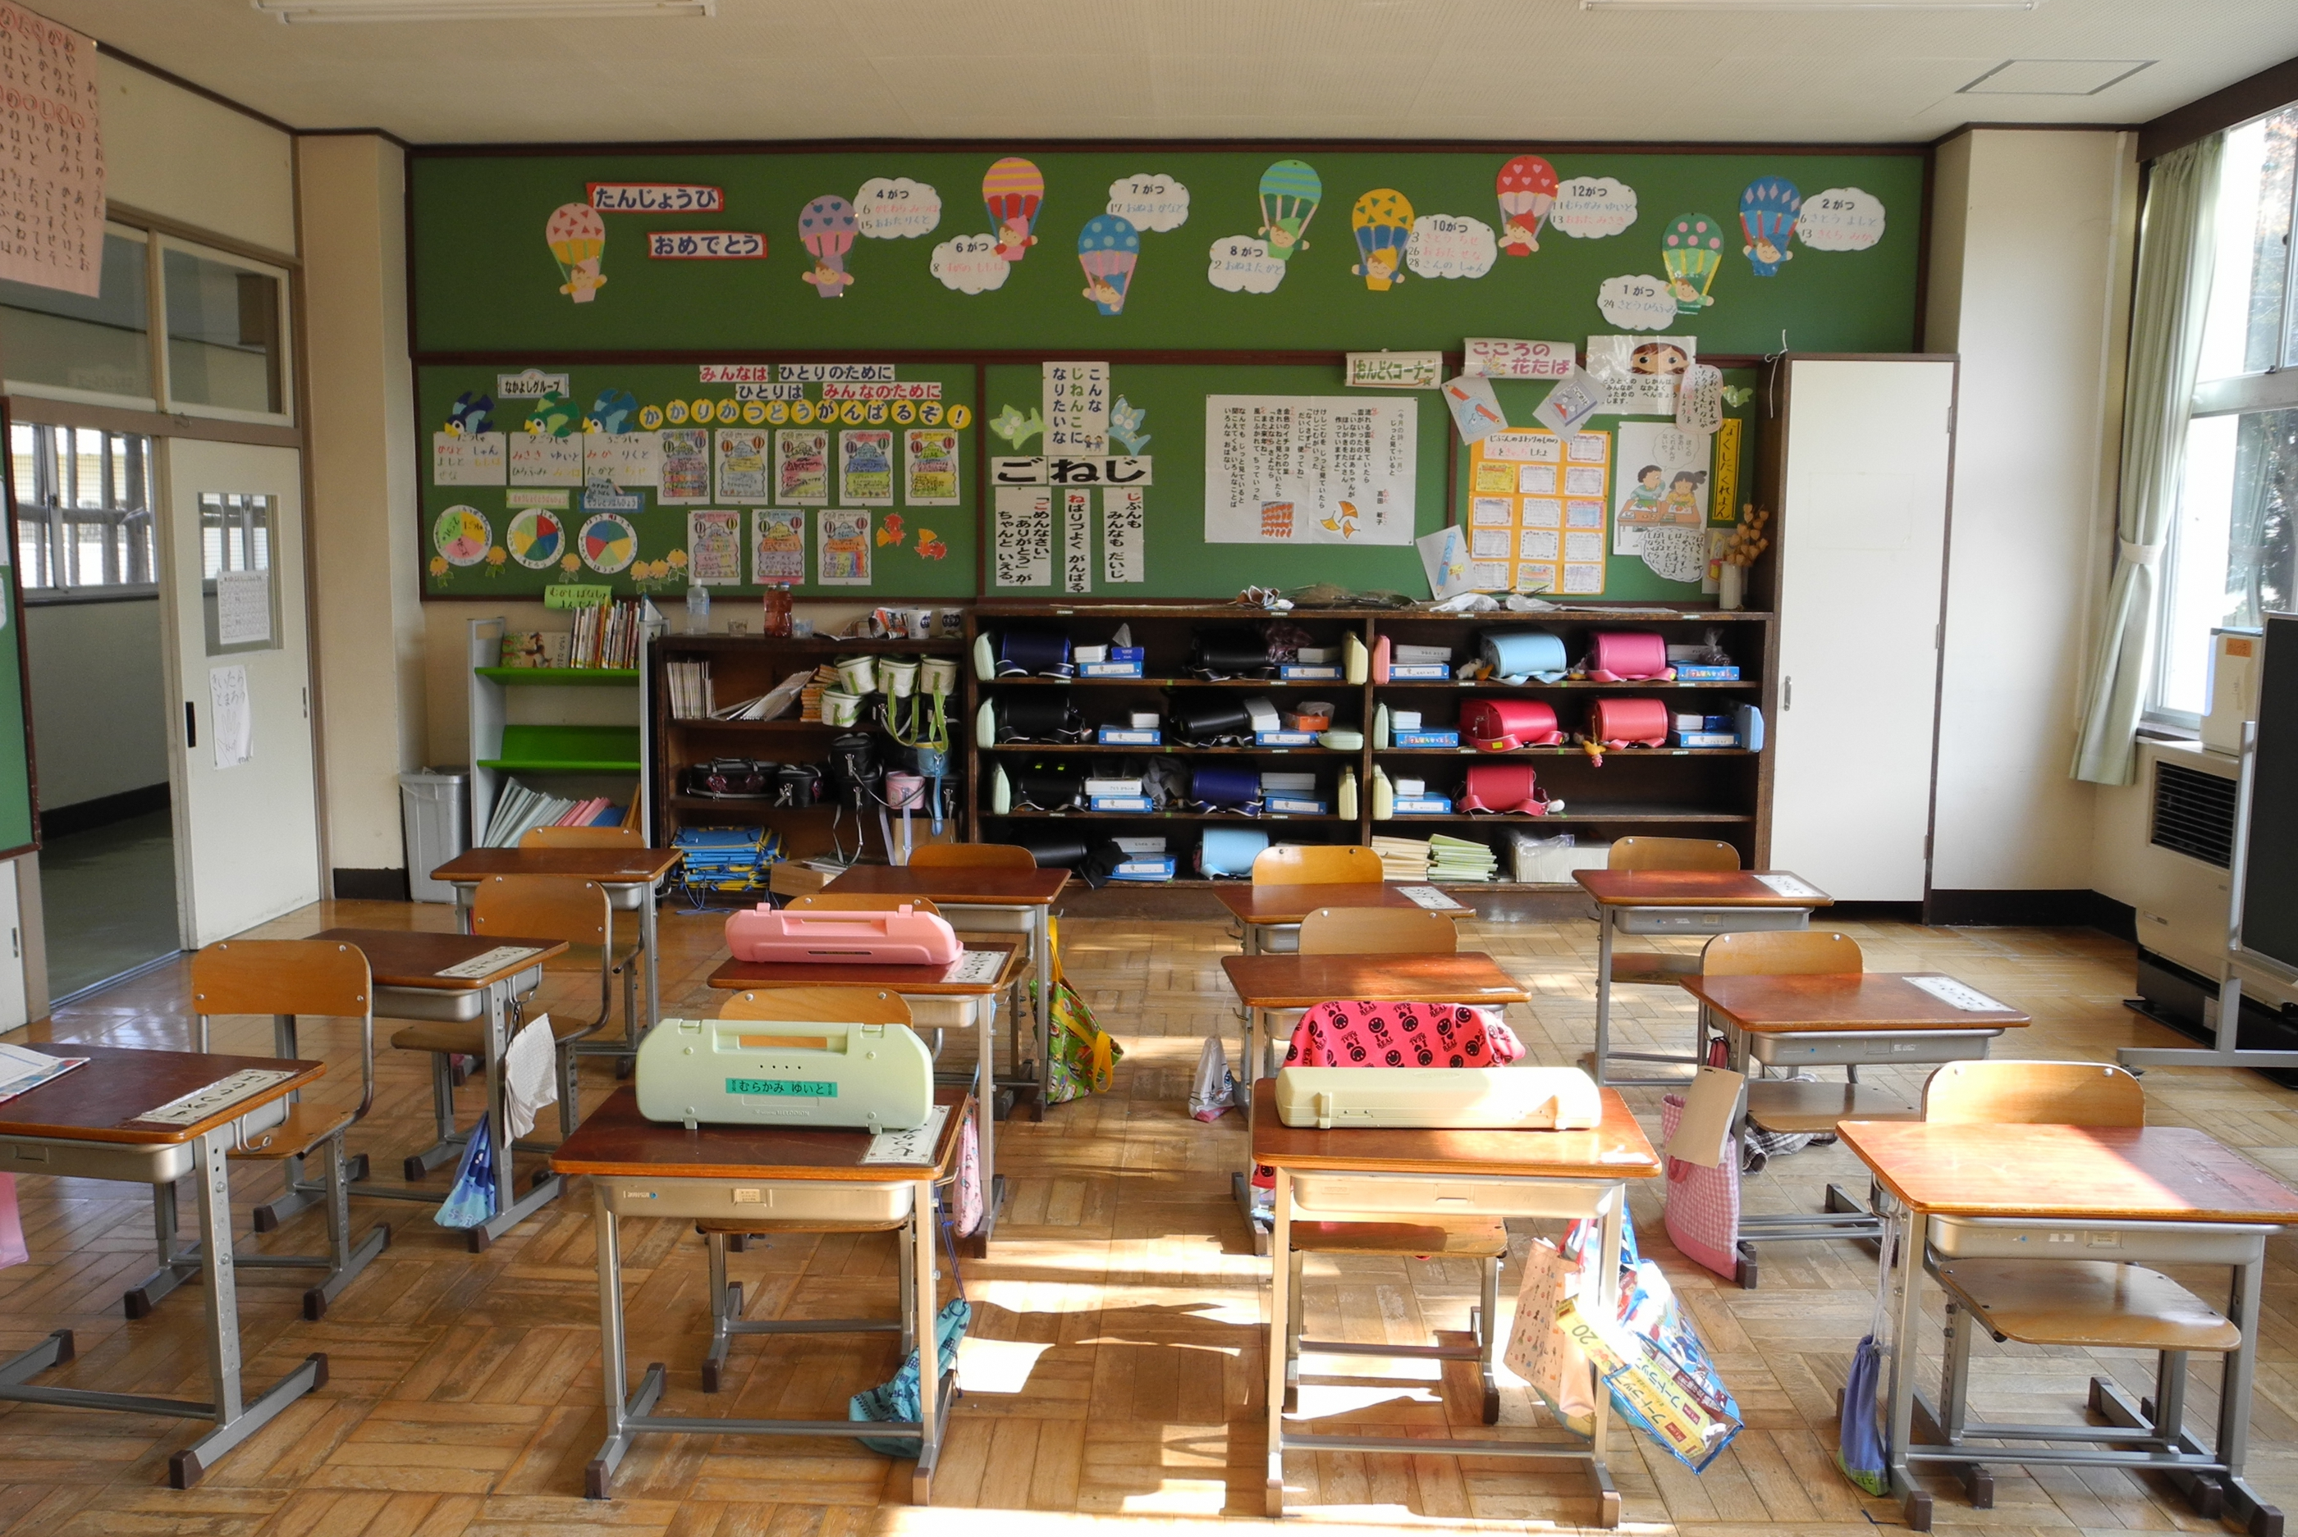
This is the classroom, where I will learn new things!
Sometimes I may want to get up from my chair and move, and that’s okay.
When I need a break, I can raise my hand and ask for one!
I can take deep breaths or stretch my arms and legs!

Slide 8

Super Star!
I am brave!
I am smart!
I am kind!
I will do my best at my new school!

Slide 9

See you at Recess!
I LOVE SCHOOL!

